Slide 1
Embeddings II: Sparse & Kernel PCA, Dictionary Learning
CSCI 4360/6360 Data Science II

Slide 2

Embeddings
What is an embedding?
Mapping
Transformation
Reveals / preserves “structure”
Embedding

Slide 3
Embeddings
“Degrees of freedom” versus “intrinsic dimensionality”
Despite 64x64 pixels, only so many ways to draw a 9
Low-dimensional manifold

Slide 4
Principal Component Analysis (PCA)
Orthogonal projection of data
Lower-dimensional linear space known as the principal subspace
Variance of the projected data is maximized
Two definitions of PCA
Maximizing Variance
Minimizing Reconstruction Error

Slide 5

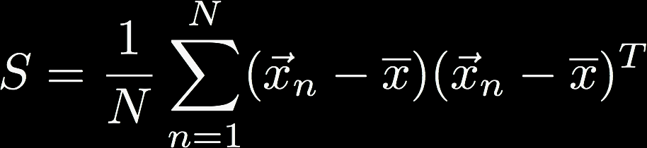
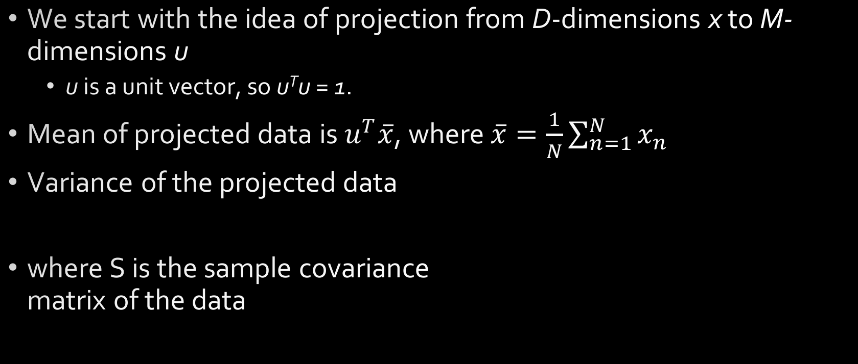
Maximizing Variance
We start with the idea of projection from D-dimensions x to M-dimensions u
u is a unit vector, so u^{T}u = 1.
Mean of projected data is $u^{T}\overline{x}$, where $\overline{x}=\frac{1}{N}\sum_{n=1}^{N}{x_{n}}$
Variance of the projected data
where S is the sample covariance matrix of the data

Slide 6



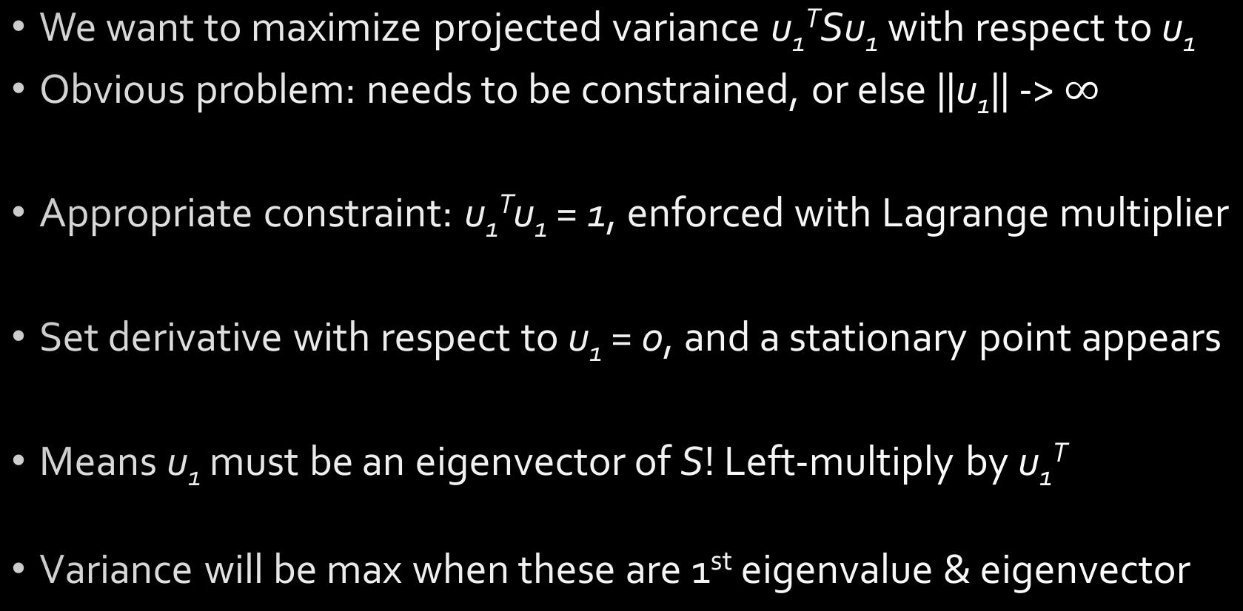
Maximizing Variance
We want to maximize projected variance u₁^{T}Su₁ with respect to u₁
Obvious problem: needs to be constrained, or else ||u₁|| -> $∞$
Appropriate constraint: u₁^{T}u₁ = 1, enforced with Lagrange multiplier
Set derivative with respect to u₁ = 0, and a stationary point appears
Means u₁ must be an eigenvector of S! Left-multiply by u₁^{T}
Variance will be max when these are 1st eigenvalue & eigenvector

Slide 7
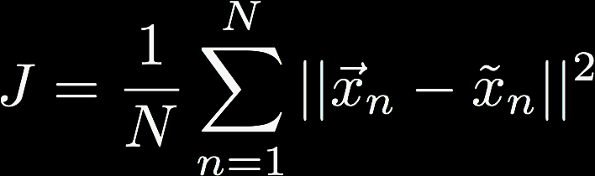
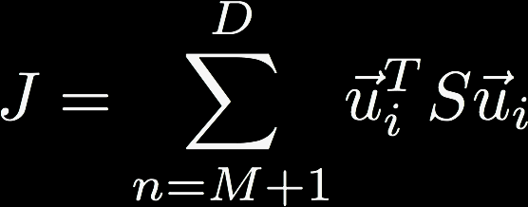
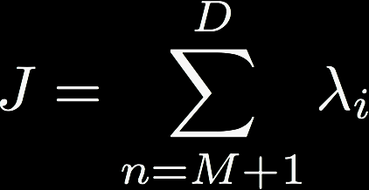
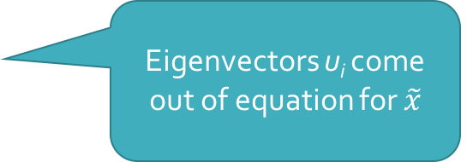
Minimizing Error
We want the reconstruction error using the first M < D principal components to be minimal
This can be rewritten purely in terms of eigenvectors u_{i}
Therefore, the distortion measure of reconstruction using the M eigenvectors of the largest eigenvalues is the sum of the remaining D - M eigenvalues
We want to minimize J
Eigenvectors u_{i} come out of equation for $\tilde{x}$

Slide 8
Minimizing Error

Slide 9
Principal Component Analysis
Advantages
Disadvantages
Optimal low-rank approximation in terms of squared reconstruction error
Completely unsupervised
Endless applications
Principal components are linear combinations (cannot generate nonlinear PCs; struggles to determine PCs in geodesic spaces)
Basis vectors are dense and sometimes difficult to interpret

Slide 10
Kernel PCA
Whenever we compute a kernel, we rely on a scalar (dot) product of the form x^{T}x
Conventional PCA is an outer product (covariance), XX^{T}
What if we replaced this with an inner product, X^{T}X
This “Gram matrix” is what we compute eigenvectors of in PCA anyway
If anything, Kernel PCA is a generalization of PCA to arbitrary similarity (kernel) functions!
First step: express conventional PCA such that data vectors x appear only in the form of scalar products

Slide 11

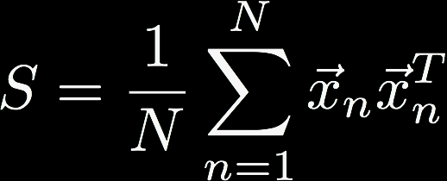

Kernel PCA
Recall that the principal components are defined by eigenvectors of the covariance matrix
and sample covariance matrix defined by
and eigenvectors are normalized such that
i is the dimensional index
N is the number of data points

Slide 12


Kernel PCA
In kernel PCA, we consider data that have already undergone a nonlinear transformation:
We now perform PCA on this new M-dimensional feature space

Slide 13
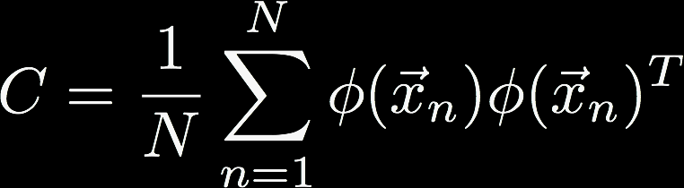

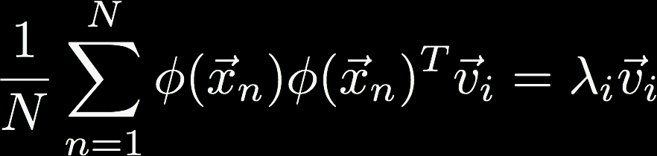
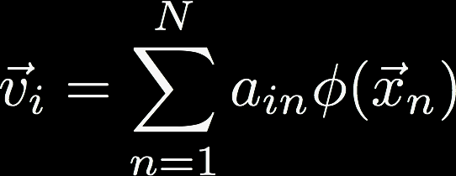
Kernel PCA
Sample covariance matrix C (now MxM)
Goal: solve the eigenvector/eigenvalue equation without having to explicitly operate in the M-dimensional feature space
Combining the two equations:
This reduces to
Notes:
Last equation works because:
- lambda_i > 0
- phi(x)^T * v_i is a dot product, i.e. a scalar (a_in)

Slide 14
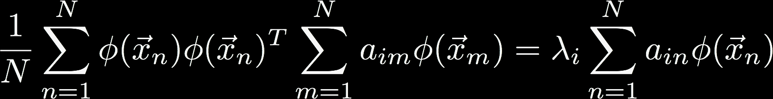
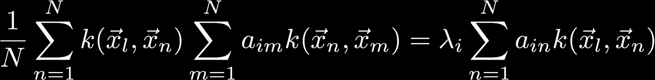
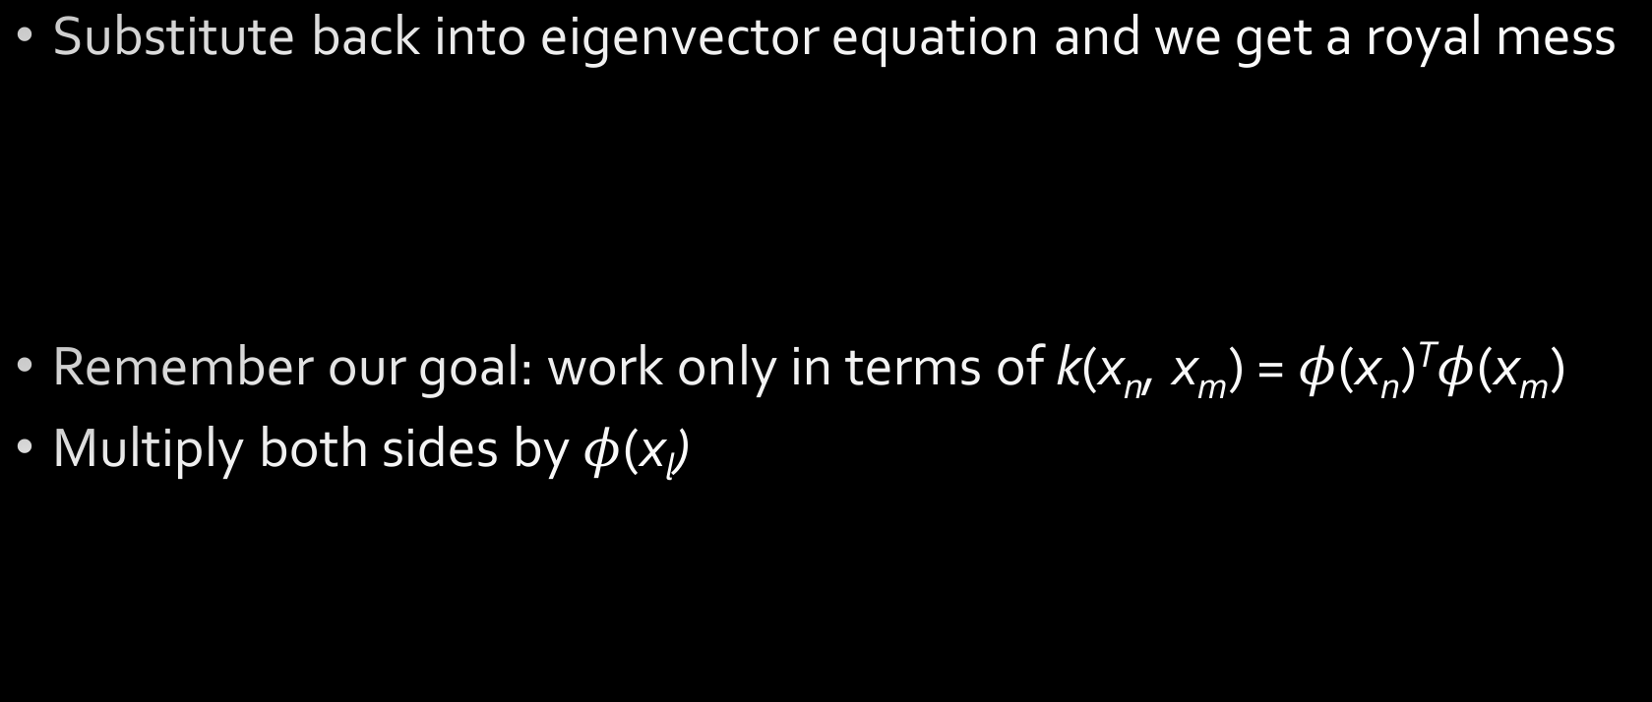
Kernel PCA
Substitute back into eigenvector equation and we get a royal mess
Remember our goal: work only in terms of k(x_{n}, x_{m}) = $φ$(x_{n})^{T}$φ$(x_{m})
Multiply both sides by $φ$(x_{l})

Slide 15


Kernel PCA
Look familiar?
Which reduces to
(there’s some normalization magic that has to happen but we’re skipping that for now)

Slide 16
Kernel PCA
Data in original data space (right panel, left subpanel) projected by nonlinear transformation into feature space (right subpanel). By performing PCA on feature space, PCs correspond to nonlinear projections in original data space.

Slide 17
Kernel PCA
Gaussian kernel applied to 2D data
First 8 kernel PCs
Contours are lines along which the projection onto the corresponding PC is constant

Slide 18
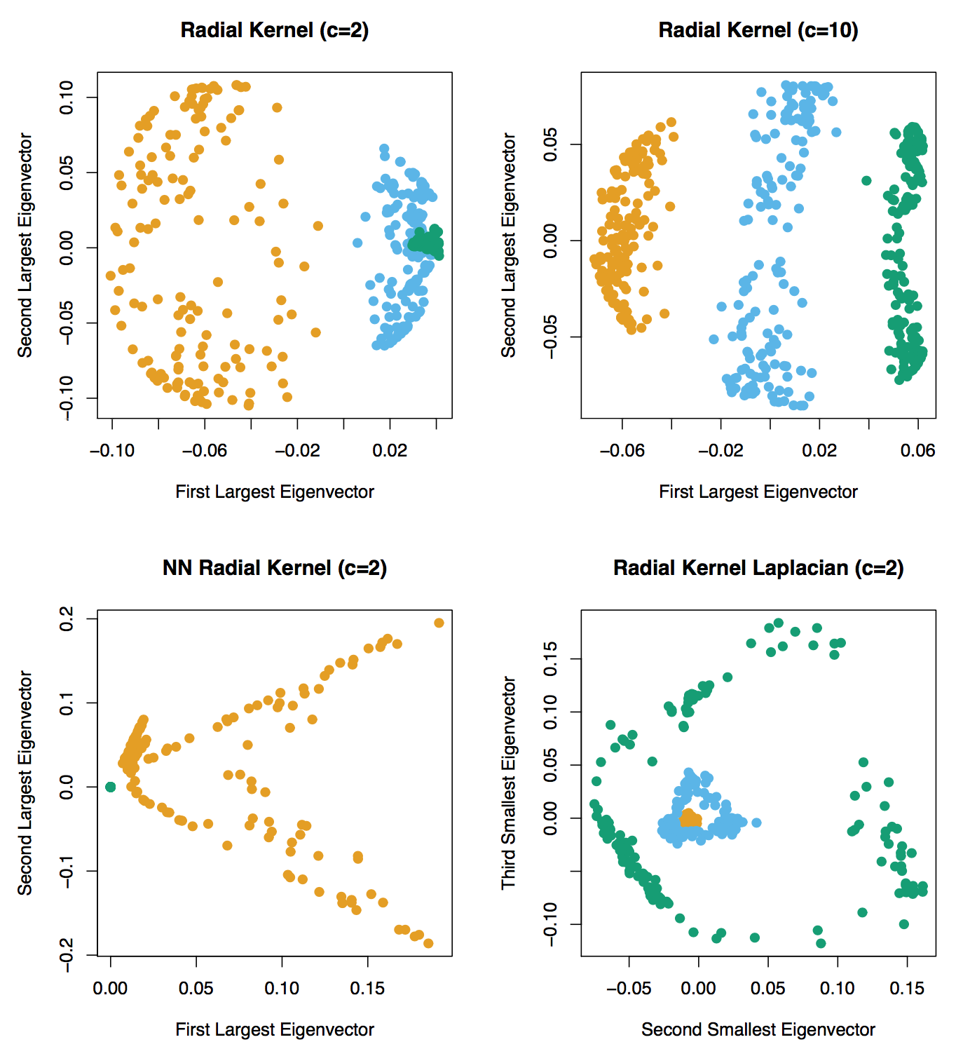
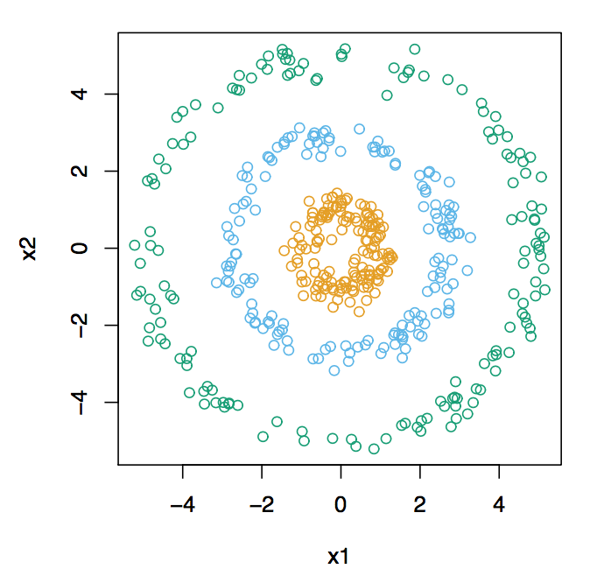
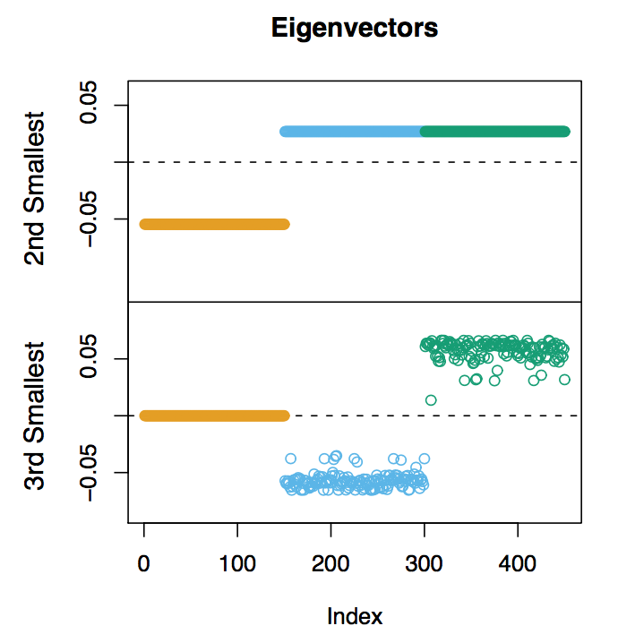
Kernel PCA
Kernelized PCs
Data
“Regular” PCs

Slide 19
Kernel PCA
Advantages
Disadvantages
Allows for nonlinear principal components
Infinitely flexible in terms of allowed kernel functions
Requires finding eigenvectors and eigenvalues of NxN matrix, instead of DxD (large N is problematic)
Cannot project new, unobserved data onto L-dimensional manifold of kernel (similar to transductive SSL!)

Slide 20
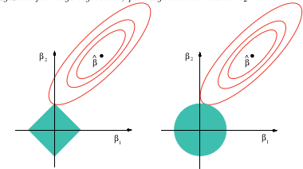
Sparse PCA
Anyone remember lasso regularization?
Regularization, in general, is a penalty to encourage small weights (remember Assignment 2)
Lasso (or L₁) forces weights to 0 so they become sparse

Slide 21
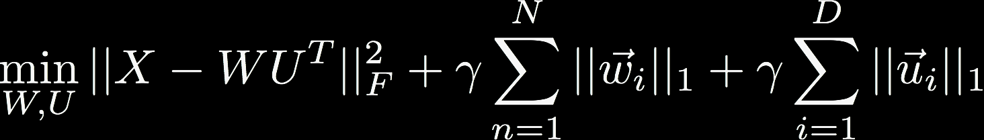
Sparse PCA
We still want to maximize u_{i}^{T}Su_{i}, subject to u_{i}^{T}u_{i} = 1
…and one more constraint: we want to minimize ||u_{i}||₁
Formalize these constraints using Lagrangian multipliers

Slide 22
Sparse PCA
Qualitatively similar to PCA, but with lots more zeros
Notes:
Figure on left: 500 non-zero values
Figure on right: only 14 non-zero values

Slide 23
Sparse PCA
Advantages
Disadvantages
Simpler and more interpretable components
Resulting components are very similar to “standard” PCA
Optimization procedure is non-convex (often use some version of alternating least-squares)

Slide 24
Dictionary Learning
“Given a set of signals belonging to a certain class, one wishes to extract the relevant information by identifying the generating causes; that is, recovering the elementary signals (atoms) that efficiently represent the data.”
Regularization, Optimization, Kernels, and Support Vector Machines, Ch. 2
Every embedding strategy ever?

Slide 25
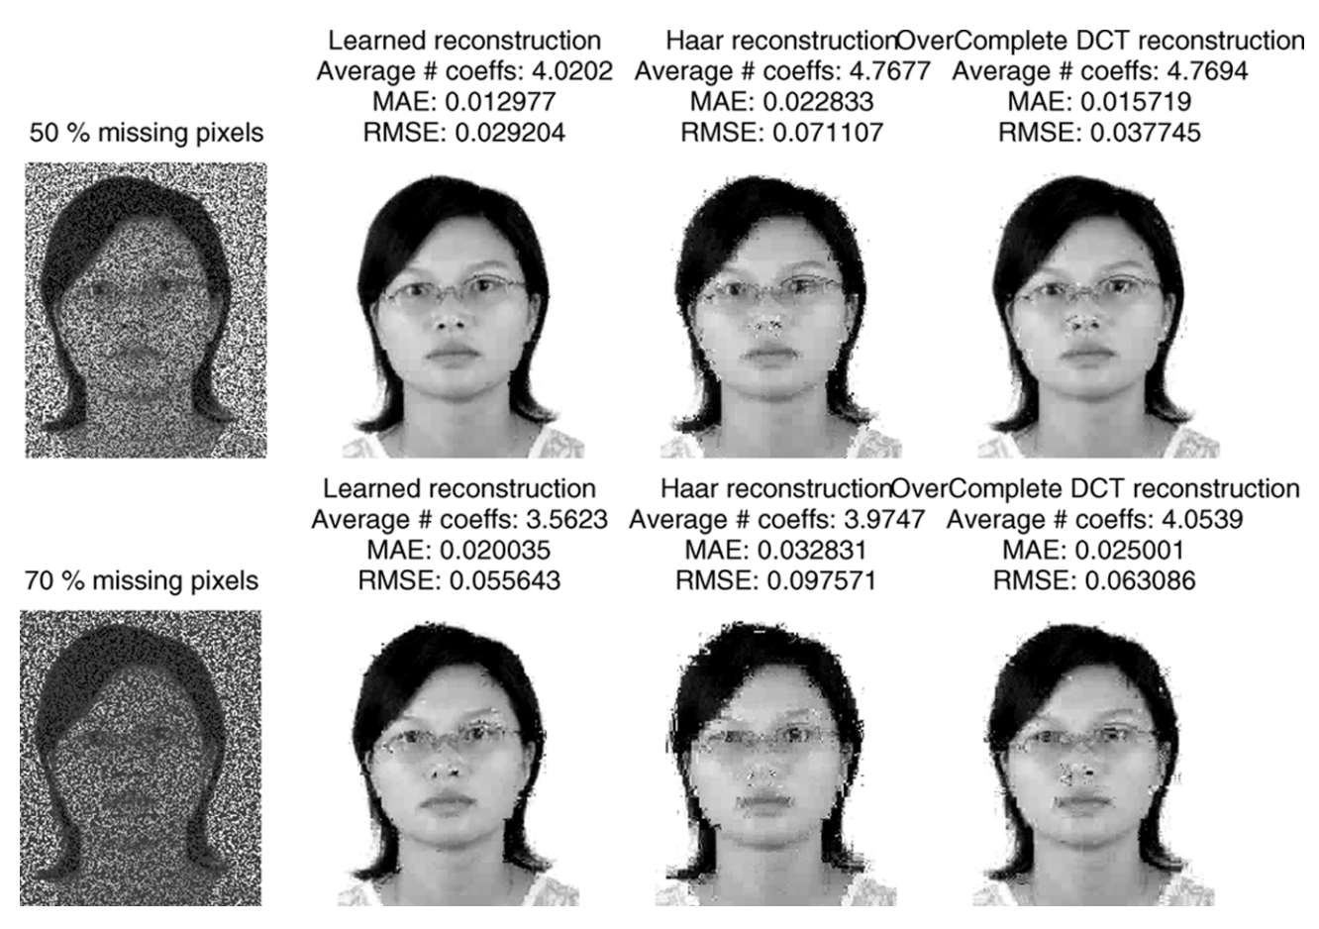
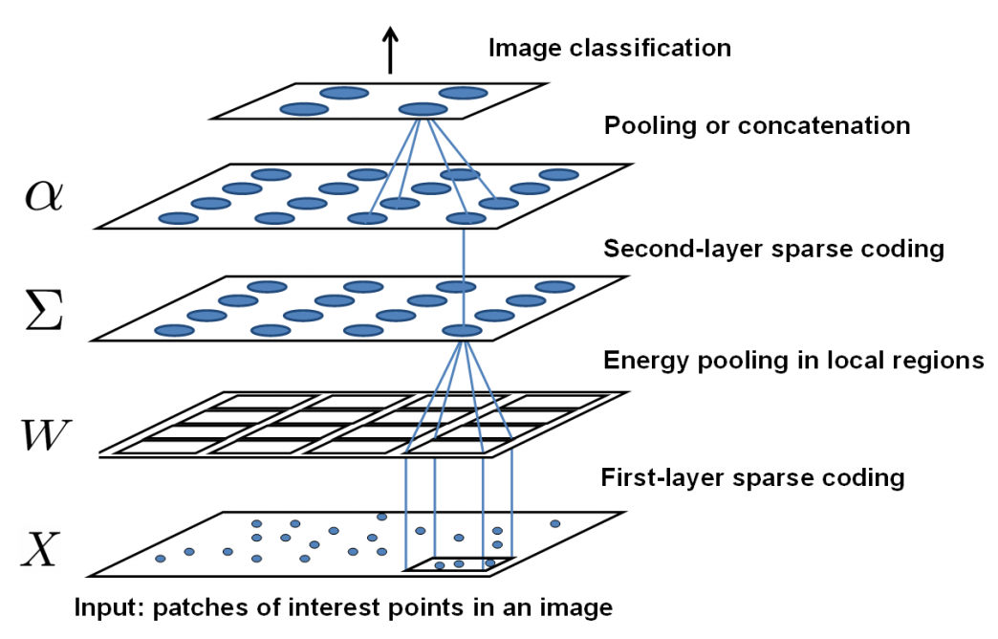
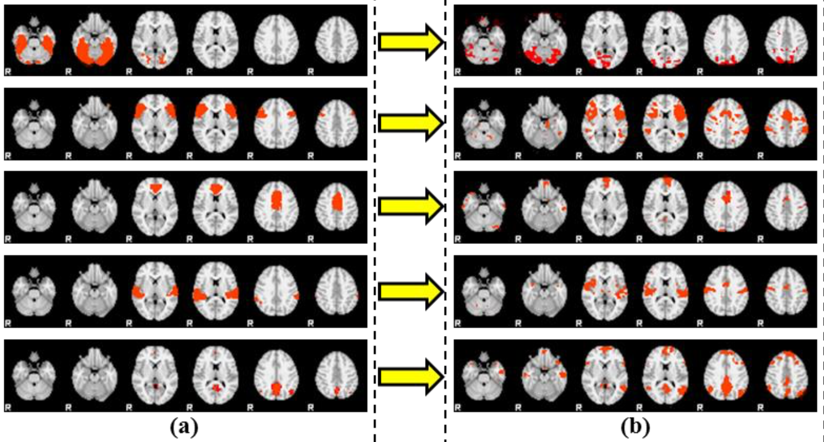
Dictionary Learning
Sparse coding
l^{p} sparsity
Hierarchical sparse coding
K-SVD
Elastic net

Slide 26
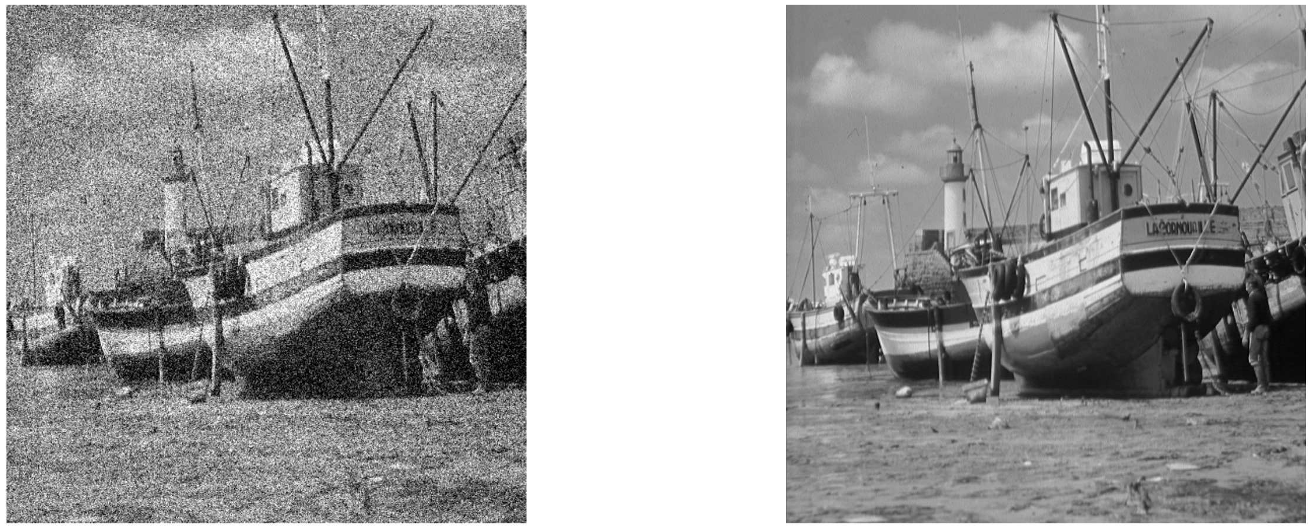

Motivations
Dictionary learning is ideally formulated for image denoising (and is indeed a major application of dictionary learning)
Measurements (image)
Noise
Original image

Slide 27





Motivations
Easily converted to an energy minimization problem
Some classical priors
Smoothness
Total variation
Wavelet sparsity
Lasso
…
Energy minimization becomes a MAP estimation!

Slide 28


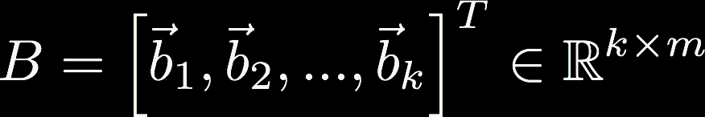
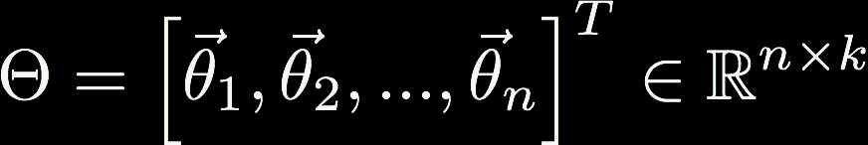
Dictionary Learning
We have our data X
and wish to represent it using some small number k atoms (k <<< n)
When combined with coefficients, the linear combinations with the atoms should yield a nearly complete representation of X
Notes:
B is the dictionary
Theta are the coefficients, or codes (want these to be sparse)

Slide 29
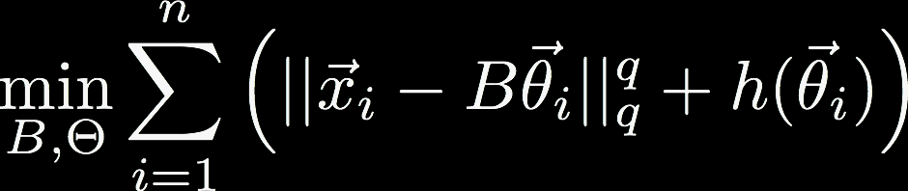

Dictionary Learning
This gives the minimization where h promotes sparsity in the coefficients, and B is chosen from a constraint set
The general dictionary learning problem then follows where specific choices of h and g are what differentiate the different kinds of dictionary learning (e.g. hierarchical, K-SVD, etc)

Slide 30
Dictionary Learning vs PCA
Remember the operational definition of PCA?
Orthogonal projection of data
Lower-dimensional linear space known as the principal subspace
Variance of the projected data is maximized
Dictionary Learning (sparse coding)
Minimize reconstruction error
Linear combination of atoms
Sparse, overcomplete basis
Objectives are reconstruction, sparsity, and redundancy
Two definitions of PCA
Maximizing Variance
Minimizing Reconstruction Error

Slide 31
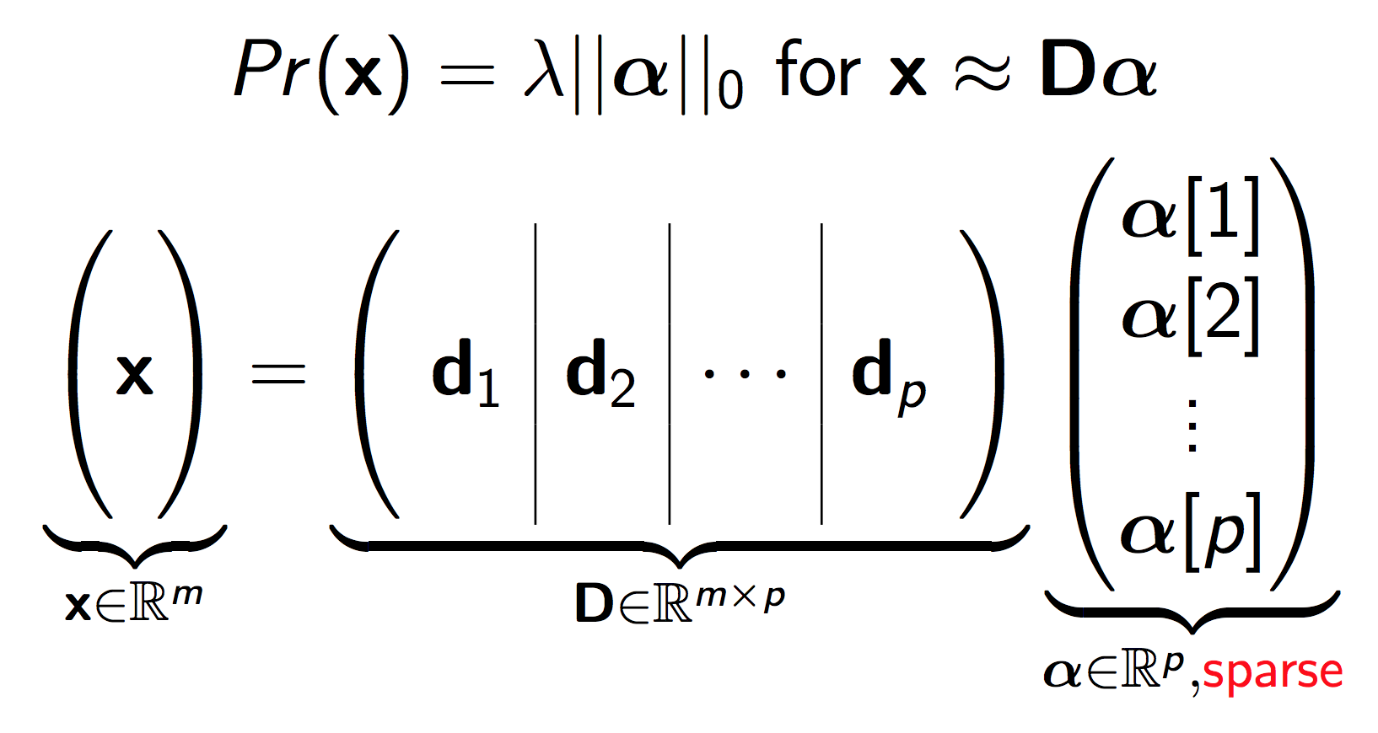
Dictionary Learning

Slide 32

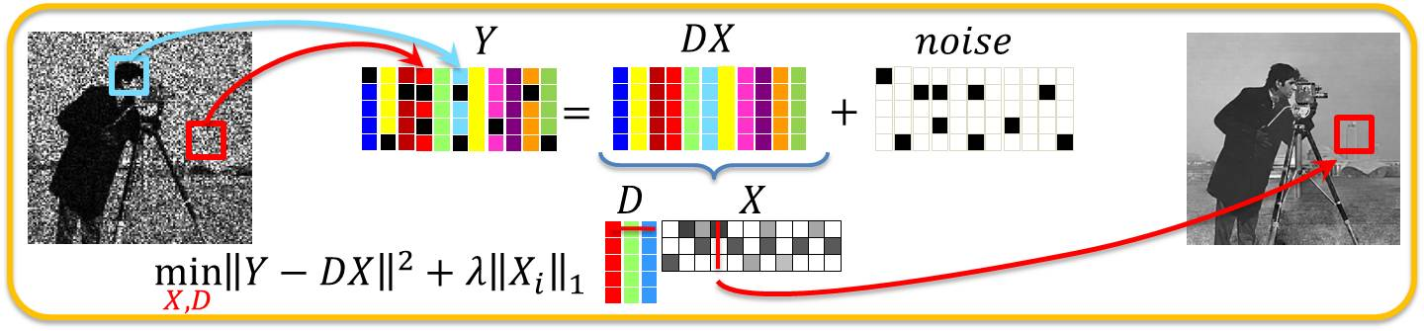
Applications
Image denoising
Sparse basis forces out noise
Identification of functional networks of neurons
Image, video, audio processing
Clustering
Bag-of-words modeling for object categorization
Image restoration & inpainting

Slide 33

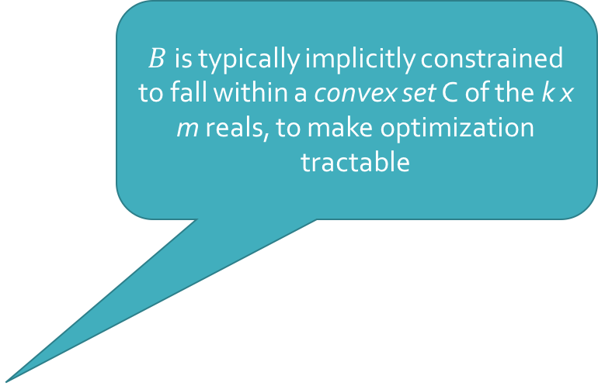
Dictionary Learning
$B$ is typically implicitly constrained to fall within a convex set C of the k x m reals, to make optimization tractable
General formulation
More common: set g to identity*, and h to L₁ norm
Notes:
The convex set is implicit, but necessary, to ensure that the coefficients do not vanish & thereby make the regularization effect disappear

Slide 34
Optimization
Problems with the objective function?
Squared loss is convex
Regularization is convex
Squared loss + regularization is not convex
Even worse, often non-smooth

Slide 35



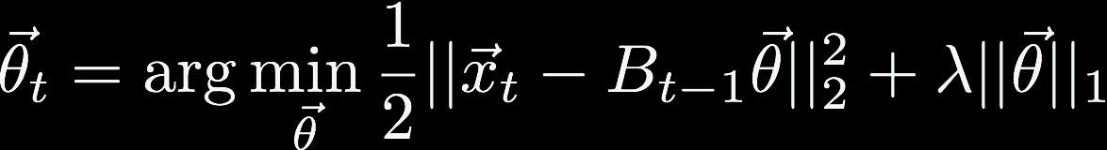
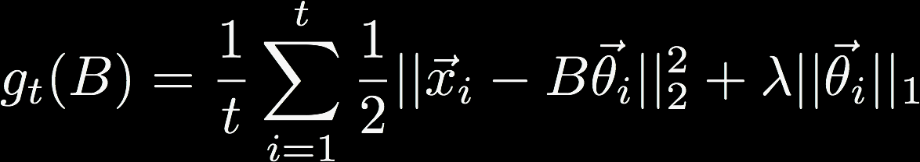
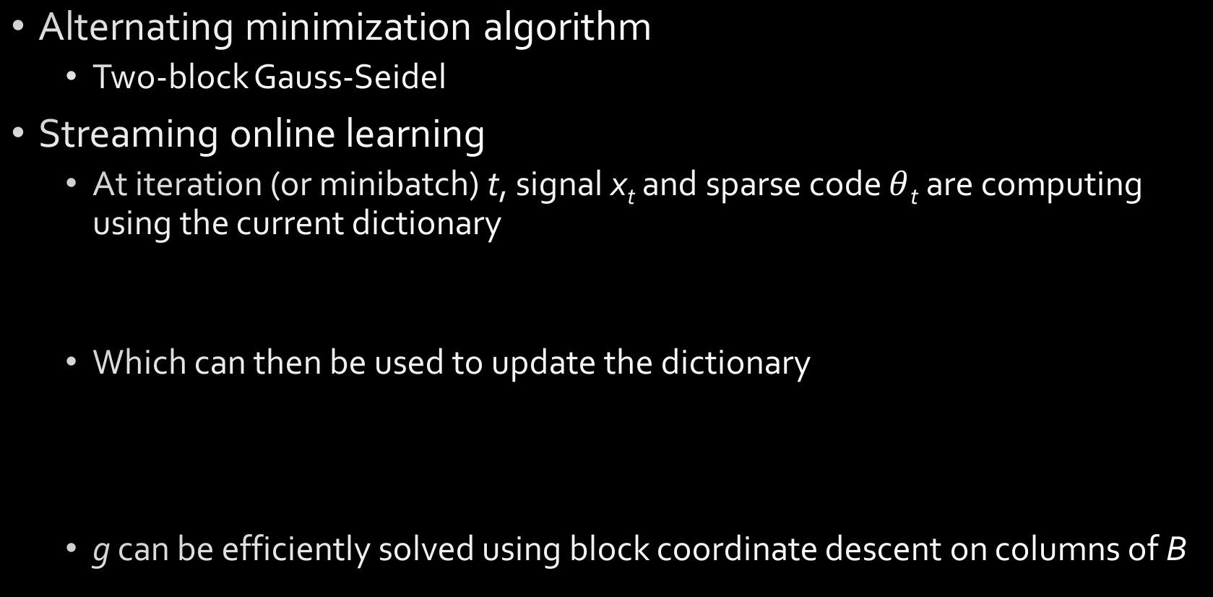
Optimization
Alternating minimization algorithm
Two-block Gauss-Seidel
Streaming online learning
At iteration (or minibatch) t, signal x_{t} and sparse code $θ$_{t} are computing using the current dictionary
Which can then be used to update the dictionary
g can be efficiently solved using block coordinate descent on columns of B

Slide 36
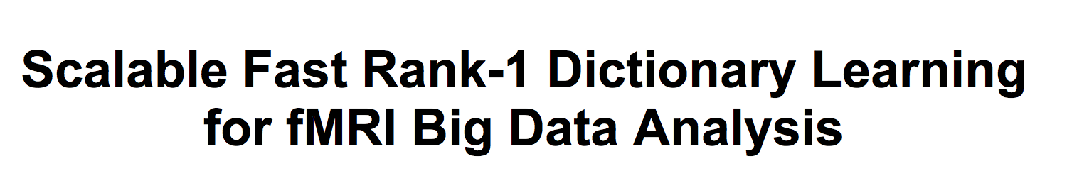
Rank-1 Dictionary Learning (R1DL)
KDD 2016
“Scalable fast”

Slide 37
R1DL
Reformulates dictionary learning as an alternating least-squares problem
(embraces the optimization procedure)
Uses 0-”norm” instead of L₁
Given rank-1 formulation, this is an inexpensive way of guaranteeing sparsity
Iteratively learns rank-1 dictionary atoms until k have been found
”Deflates” data matrix on each iteration

Slide 38

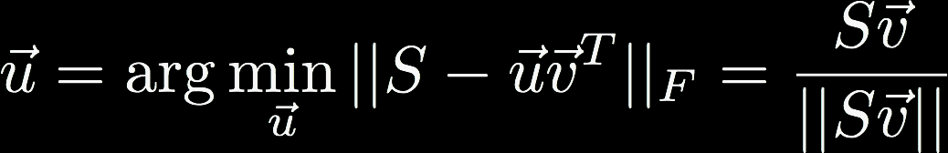




R1DL
Energy function L
Data matrix S, vectors u and v
|| u || = 1
|| v ||₀ $≤$ r, where r is the sparsity constraint (literally, # of nonzero elements in v)
Iterate until convergence of u (atoms) and v (sparse codes)
“Deflate” data matrix
Repeat until k atoms & sparse codes are learned

Slide 39
Summary
Principal Components Analysis
Classic dimensionality reduction technique
Kernel PCA
Introduces nonlinearities into component vectors
Permits use of arbitrary similarity functions
Can capture much richer and more complex interactions in data
Much more expensive to compute than PCA
Sparse PCA
Qualitatively similar results to PCA
Components are sparse, improving interpretability
Learning procedure is non-convex, typically requiring ALS

Slide 40
Summary
Dictionary learning is focused on developing a basis of atoms and coefficients
Coefficients are sparse
Atoms form an overcomplete representation of the data
Chosen to minimize reconstruction error
Explicitly factorizes out noise
Can be customized in the form of a prior
Optimization is often non-convex and non-smooth, requiring alternating minimization strategies or online learning
R1DL focuses on leveraging optimization strategies to iteratively learn the basis, one atom at a time
Other variants include K-SVD, Hierarchical DL, and Elastic Net

Slide 41
Questions?

Slide 42
Up Next
Tomorrow: workshop 6
Please attend, even if you aren’t presenting!
Thursday: Guest Lecture!
Meekail Zain, PhD Candidate
Next Tuesday: workshops 7 and 8
Next Wednesday: In-class Q&A for midterm prep
Next Thursday
Midterm exam!
HW3 due!
SPRING BREAK
No HW, BUT: start thinking about final projects (topic, teammates, etc)

Slide 43
Resources
http://alexhwilliams.info/itsneuronalblog/2016/03/27/pca/
Elements of Statistical Learning, Chapter 14 http://statweb.stanford.edu/~tibs/ElemStatLearn/printings/ESLII_print10.pdf
Pattern Recognition and Machine Learning, Chapter 12
Machine Learning: A Probabilistic Perspective, Chapter 14
An Introduction to Statistical Learning, Chapter 10 http://www-bcf.usc.edu/~gareth/ISL/ISLR%20Seventh%20Printing.pdf

